Slide 1
HEXAPOD - a six legged Robot
-Nisarg K. Patel [EC099] id=22ecuos113
-Krish S. Patel [EC097] id=22ecuos026

Slide 2
CONTENTS
Project Overview
Key Components & Specifications
Hardware Architecture
Power Management System
Control System
Motion Control & Inverse Kinematics
Vision System
Costing
Challenges & Solutions
Future Improvements

Slide 3
What is a Hexapod
As it's name suggests, it is a six legged robotic platform designed to mimic the locomotion of insects.
This design offers a exceptional stability and is adaptable to most of the terrains such as uneven terrains i.e forests, rocky surfaces , soft terrains i.e deserts and mud etc.
This is possible because it is a synchronous 3 leg movement. When 3 legs are moved up for going forward other 3 legs gives a full stability which make this robot different from other.

Slide 4
OVERVIEW
The Hexapod is an advanced six-legged robot platform designed for stable locomotion across various terrains. Inspired by insects, the hexapod design offers exceptional stability and adaptability compared to wheeled or bipedal robots.
Our implementation features:
18 degrees of freedom (3 servos per leg)
Real-time video streaming capabilities
Custom battery management system
Programmable walking gaits
Obstacle avoidance

Slide 5

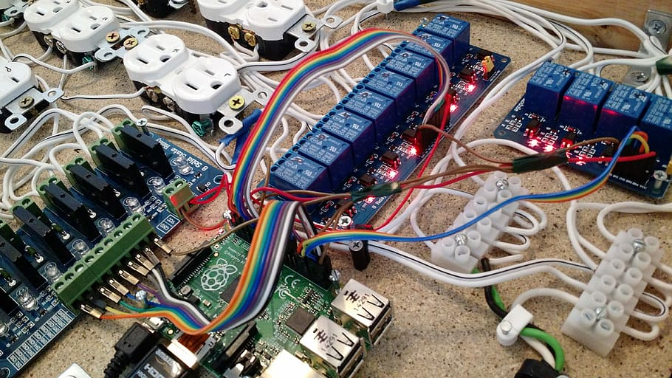
KEY COMPONENTS
AND
SPECIFICATIONS

Slide 6
Major Components
MG996R Servo motor
Arduino Mega
BLUETOOTH Module –HC-05
ESP32 CAM MODULE
BUCK CONVERTERS
3S 100A LIFEPO4 BMS

Slide 7
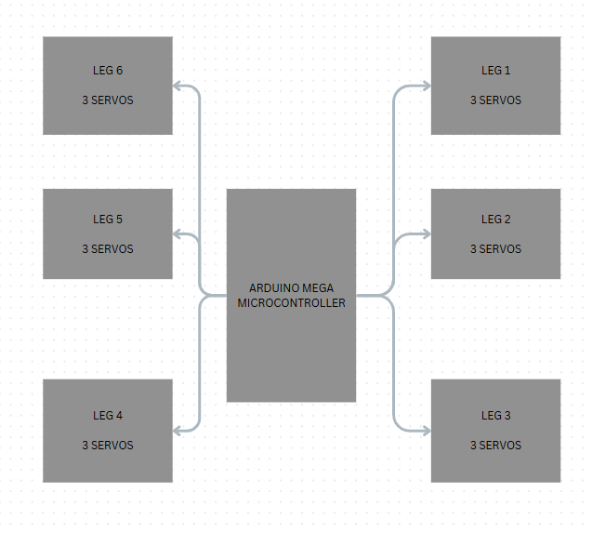
BLOCK DIAGRAM

Slide 8
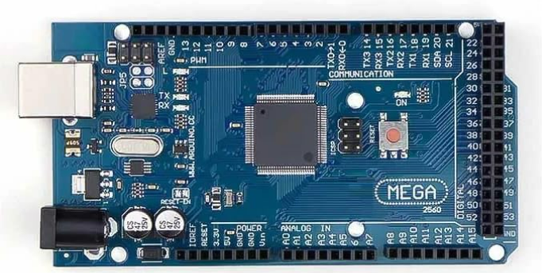
ARDUINO MEGA
SPECIFICATIONS:
Microcontroller: ATmega2560
Operating Voltage: 5V
Input Voltage: 7-12V (recommended)
Digital I/O Pins: 54 (15 with PWM)
Analog Input Pins: 16
Flash Memory: 256 KB
Clock Speed: 16 MHz

Slide 9
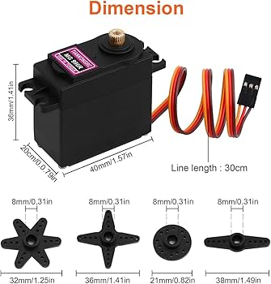
MG996R SPECIFICATIONS
Operating Voltage: 4.8V to 6V DC
Operating Speed: 0.19 sec/60° at 4.8V, 0.14 sec/60° at 6V
Stall Torque: 9.4 kg·cm (4.8V), 11 kg·cm (6.0V)
Dead Band Width: ≤ 5 µs
Working Angle: 0° to 180°
Maximum Rotation Angle: 0° to 360° (if modified)
Weight: 55g
Dimensions: 40.7 x 19.7 x 42.9 mm
Gear Type: Metal gears
Motor Type: Coreless motor
Connector: 3-pin (Orange: Signal, Red: VCC, Brown: GND)
Current Draw: Idle: 10 mA, Operating: 170-180 mA, Stall: ~2.5 A
Applications: Robotics, RC vehicles, hexapods, control arms.

Slide 10
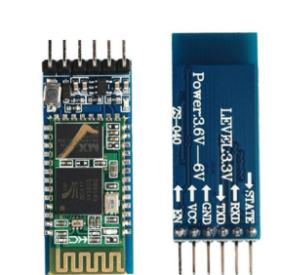
BLUETOOTH MODUEL HC05
Protocol: Bluetooth 2.0+EDR
Frequency: 2.4GHz ISM band
Modulation: GFSK (Gaussian Frequency Shift Keying)
Communication Range: ~10 meters
COMMUNICATION : UART
Default Baud Rate: 9600 bps (configurable 1200-115200)
Operating Voltage: 3.3V-6V (5V typical)
Current: 30mA (typical)
Working Mode: Master/Slave switchable
Default Password: "1234" or "0000"

Slide 11
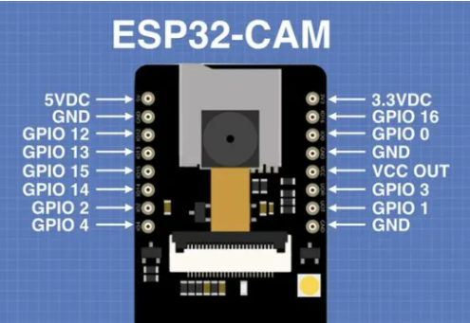
ESP32 CAMERA MODULE
ESP32-S Dual Core processor
OV2640 2MP camera
Wi-Fi connectivity for streaming
Real-time video transmission
Resolution: Up to 1600×1200
Frame Rate: Up to 25 fps
Primarily, uses Wi-Fi (IEEE 802.11 b/g/n) and Bluetooth (4.2 BR/EDR and BLE) protocols.

Slide 12
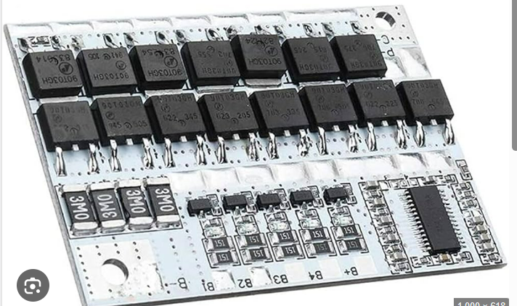
BMS MODULE
3S LiPo Battery Configuration (11.1V)
100A Battery Management System (BMS)
Features:
Cell balancing
Overcharge/discharge protection
Short circuit protection

Slide 13
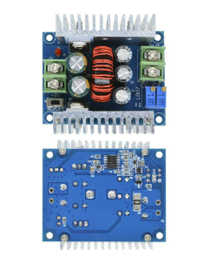
BUCK CONVERTER
Type: DC-DC Buck Converter (Step-Down)
Power Capacity: 300W
Output Current: 20A (Max)
Applications: LED driver, battery charging, vehicle power supply, and more.
Input Voltage:
Range: 6V to 40V DC
Output Voltage:
Range: Adjustable from 1.25V to 36V DC
Other Key Specifications:
Efficiency: Typically around 97%
Switching Frequency: Around 180 kHz
Output Ripple: ≤ 50mV

Slide 14
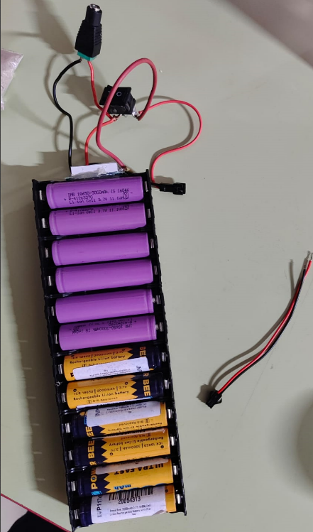
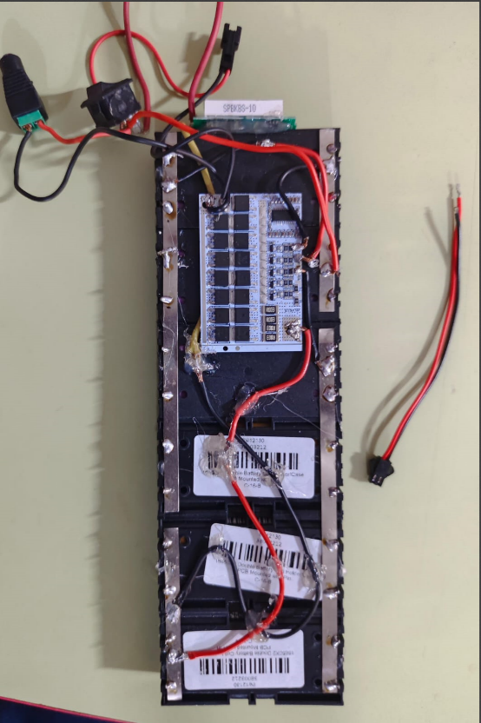
BATTERY PACK - 12000mAH
CONNECTED IN 3 SERIES CONNECTION.
EACH 3000mAH CELL connected parallely with other 3 cells, I,e 4 cells in parallel.
And those 4 cell box each connected in series with other two 4 parallel cell boxes.

Slide 15
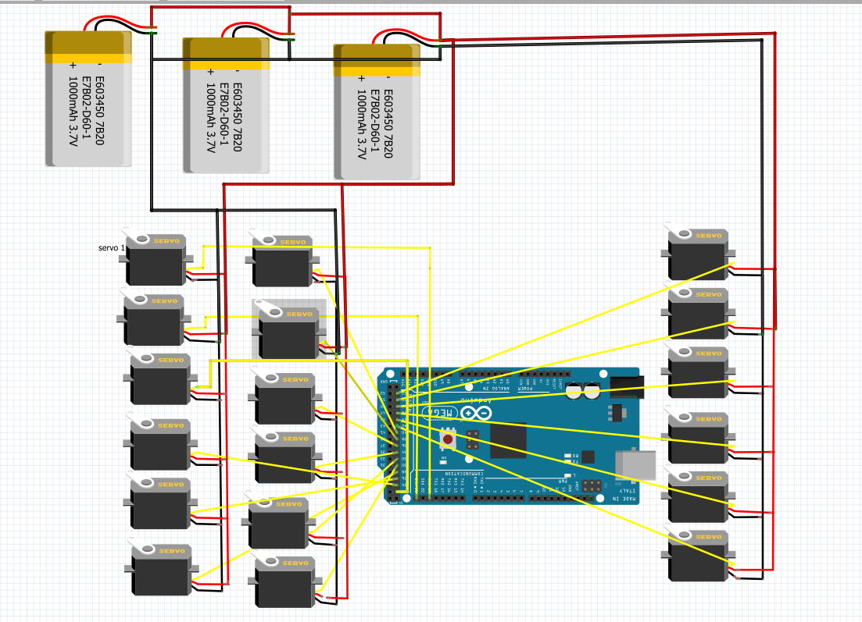
Circuit diagram

Slide 16
Costing
COMPONENT | PRICE
Servo motor (x18) | 6300
ARDUINO MEGA | 1300
3S 100A BMS | 450
BUCK CONVERTERS (4 PIECES) | 900
ESP32 CAMERA MODULE | 550
Bluetooth module | 250
3-D printed body parts | 5600
BATTERY CELLS ( 12 PIECES) | 1080
BATTERY HOLDERS, WIRES | 220

Slide 17
COMPONENT | PRICE
PAN AND TILT COUPLERS | 530
BATTERY INDICATOR | 45
JST-SM CONNECTORS | 20
DC PIN PLUGS | 45
TOTAL | 17290/- RS

Slide 18
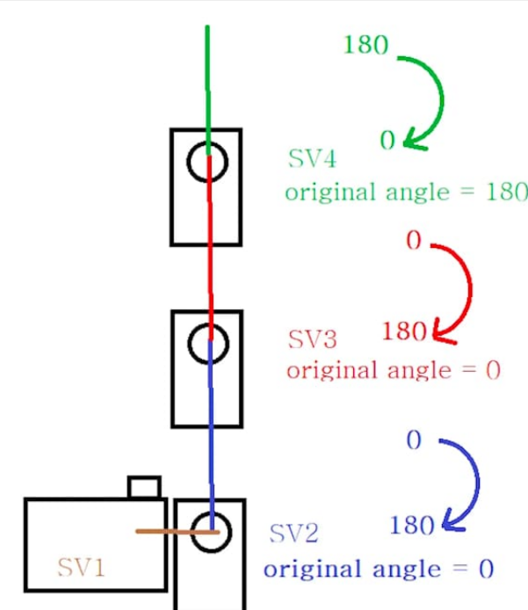
Setup-module working

Slide 19
Challenges and solutions:
1. Locomotion and Gait Complexity
Challenge
Designing stable and efficient walking patterns for six legs is significantly more complex than bipedal or quadrupedal robots.
Solutions
Implement adaptive gait algorithms that can dynamically adjust leg movements
Use inverse kinematics to calculate precise leg positioning
Develop terrain-aware walking algorithms that can:
Detect surface irregularities
Adjust leg placement in real-time
Maintain center of gravity during movement
2. Mechanical Stability
Challenge
Ensuring structural integrity while maintaining lightweight design and flexibility.
Solutions
Use advanced materials like carbon fiber or aerospace-grade aluminum
Design modular leg mechanisms with:
High-precision servo motors
Robust joint connections
Shock-absorbing mechanisms
Implement sophisticated balance control systems using:
Gyroscopic sensors
Accelerometers
Distributed weight sensing

Slide 20
3. Power Management
Challenge
Managing energy consumption across six independent leg actuators and control systems.
Solutions
Develop efficient power distribution architecture
Use brushless DC motors with high efficiency
Implement adaptive power management:
Dynamic voltage scaling
Intelligent sleep modes for inactive leg systems
Energy recuperation during movement
Control System Complexity
Challenge
Synchronizing six independent legs with precise coordination and minimal computational overhead.
Solutions
Distributed computing architecture
Use of FPGA or dedicated microcontrollers for leg control
Implement hierarchical control systems:
Low-level PID controllers for individual leg movement
High-level path and gait planning algorithms
Machine learning adaptive control mechanisms

Slide 21
Thank you

